Slide 1
MEDIASTINAL DISEASES
Omar Mangoush

Slide 2
Anatomy
Pathology
Clinical presentation
Investigations

Slide 3
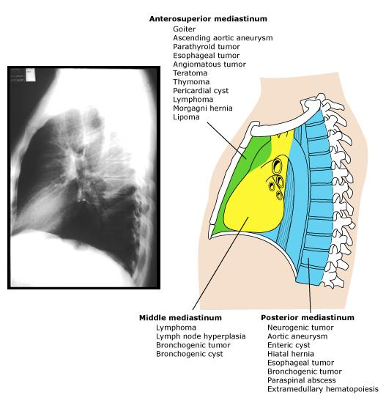
Anatomy

Slide 4
Mediastinal Pathology
None neoplastic
  Mediastinitis
  Pneumomediastinum
Congenital
  Cysts
  Hernias
Acquired
  Benign
  Malignant
Most Common:
  Thymus
  Thyroid
  Teratoma
  Lymphoma

Slide 5
Clinical Presentation
Most asymptomatic, Incidental finding
Airway compression → pneumonia
Dysphagia
Paralysis
Hoarseness – RLN
Elevated HD – phrenic
Horner’s Synd – Sympathetic
SVC synd
Haemoptysis
Constitutional
Associated with systemic disease: Mythenia, thyrotoxicosis, Cushing’s and parathyrodism

Slide 6
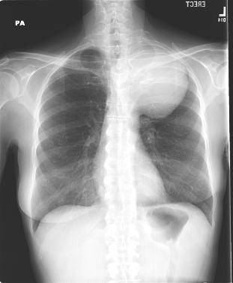
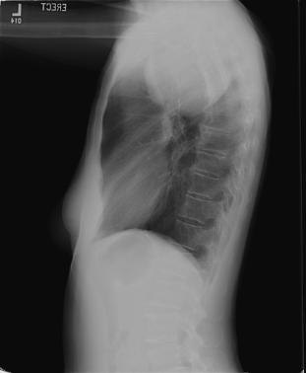
Investigations: Imaging
CXR

Slide 7
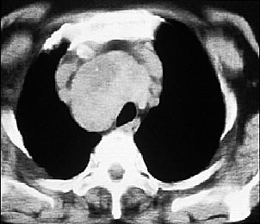
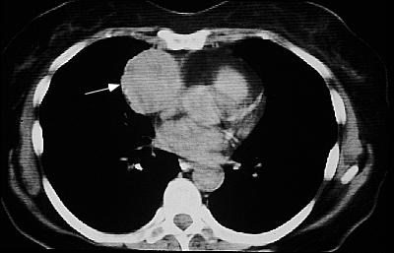
Investigations: Imaging
CT

Slide 8
Investigations: Imaging
MRI
US
PET

Slide 9
Investigations: laboratory
TFT
PTH
Urine metanephrine and catecholamines
AFP & Beta HCG

Slide 10
Investigations: histo-pathology
FNA / Tru-cut
  CT guided
  EUS guided
Mediastinoscope
Mediastinostomy
VATs
Thoracotomy

