Slide 1
Abdominal wall hernia
Dr. khalid Faiz

Slide 2
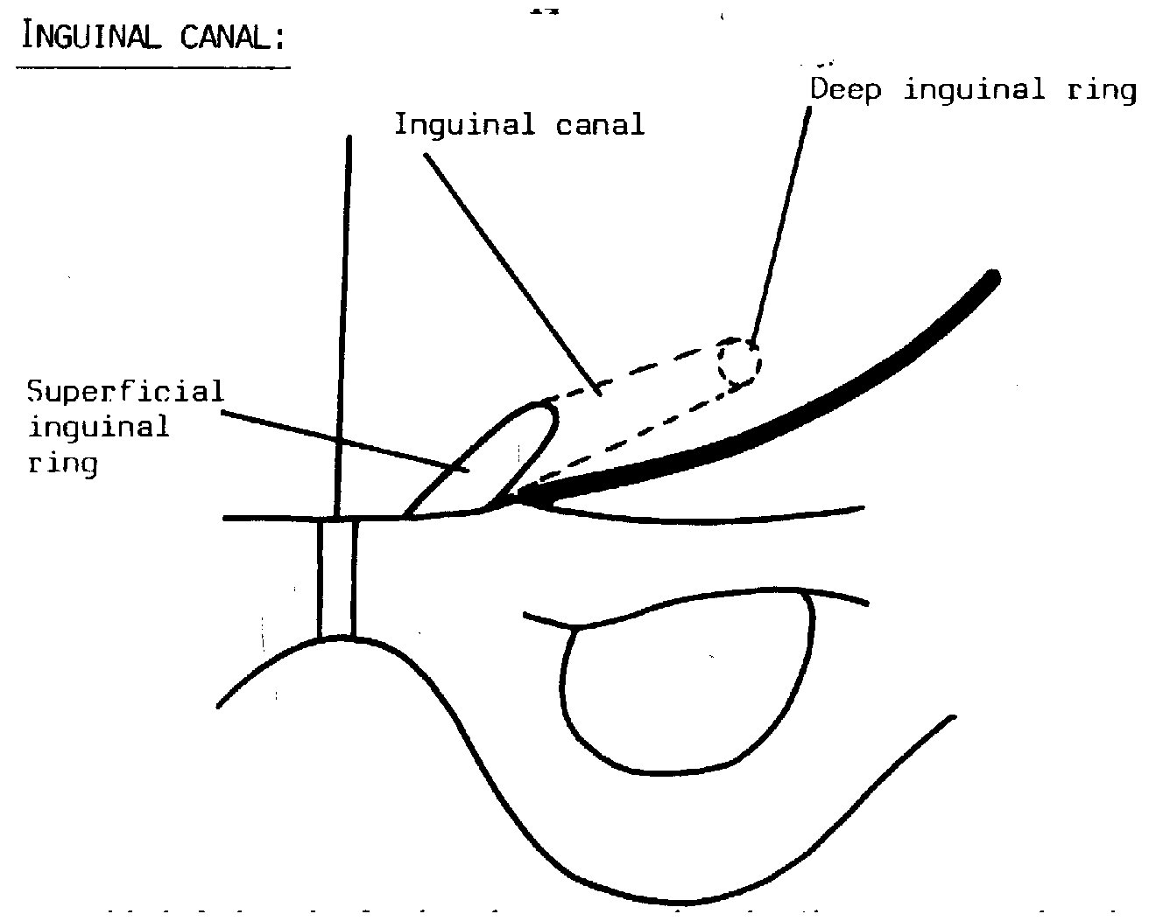
Inguinal canal
This is the passage between the deep and the superficial inguinal rings.

Slide 3
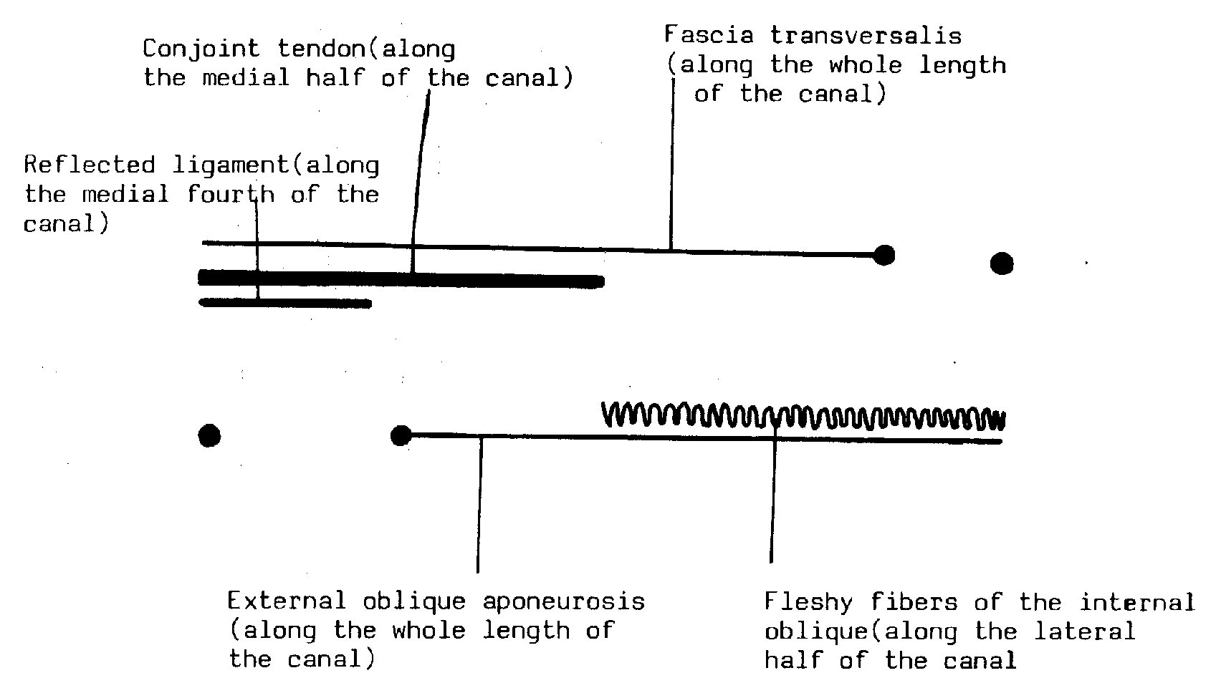
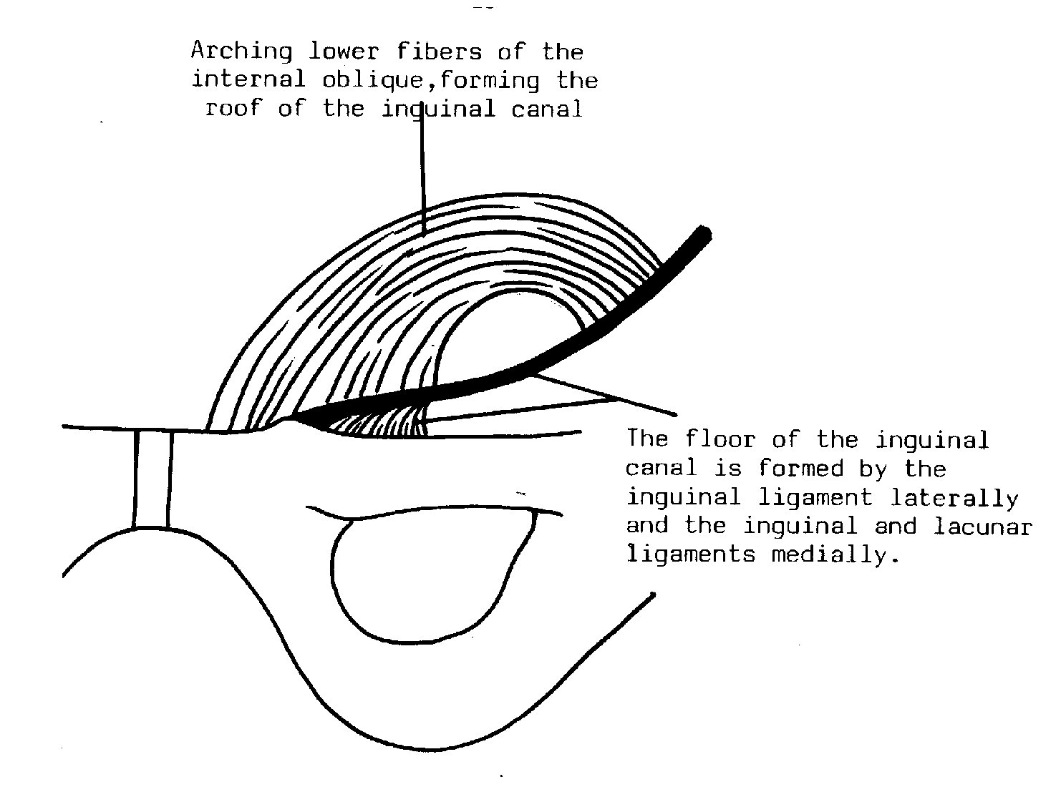
Boundaries of the canal

Slide 4
Fate of ing hernia
Types of hernia by complexity
Occult – not detectable clinically; may cause severe pain
Reducible – a swelling which appears and disappears
Irreducible – a swelling which cannot be replaced in the
abdomen, high risk of complications
Strangulated – painful swelling with vascular compromise,
requires urgent surgery
Infarcted – when contents of the hernia have become
gangrenous, high mortality

Slide 5
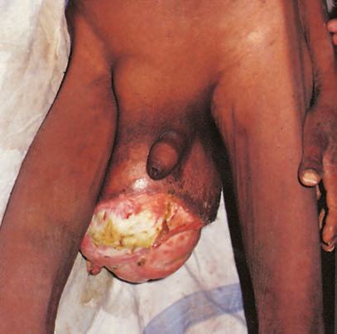

Slide 6
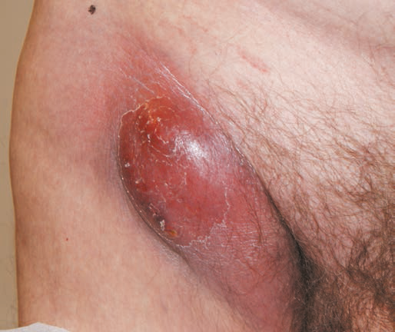

Slide 7
Femoral hernia
Femoral hernia
Less common than inguinal hernia
It is more common in females than in males
Easily missed on examination
Fifty per cent of cases present as an emergency with very
high risk of strangulation

Slide 8
Ventral hernias
Ventral hernias
Umbilical – paraumbilical
Epigastric
Incisional
Parastomal
Spigelian
Lumbar
Traumatic

Slide 9
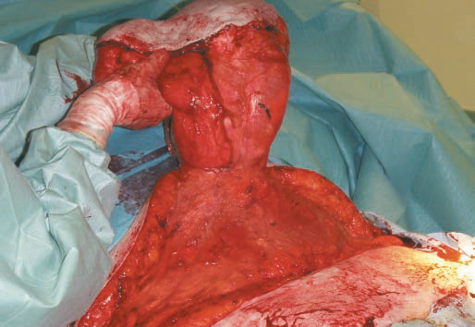
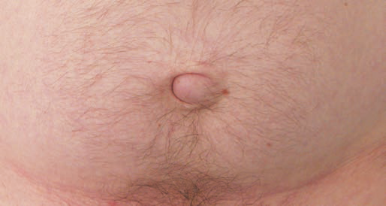
PUH

Slide 10
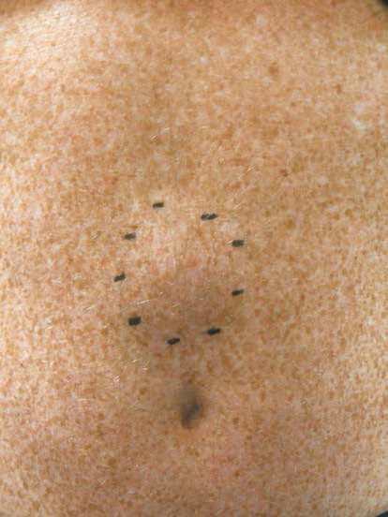
Epigastric hernia

Slide 11
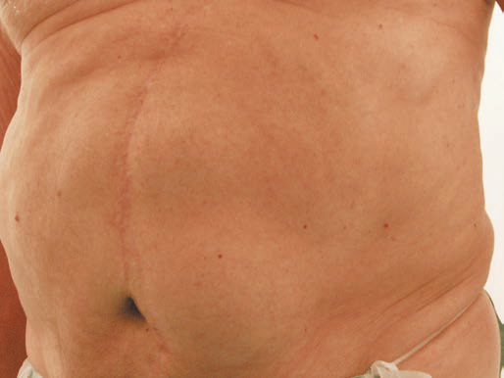
Incisionla hernia
Incisional hernia
Incidence 10–50 per cent after surgery
Causation due to patient, wound and surgeon factors
Wide variation in size
Often multiple defects within the same scar
Obstruction is common but strangulation is rare
Open and laparoscopic repairs possible

Slide 12
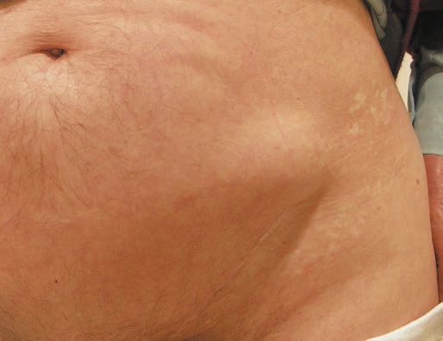
Spigelian hernia
Spigelian hernia
Rare
Often misdiagnosed
High risk of complications

Slide 13
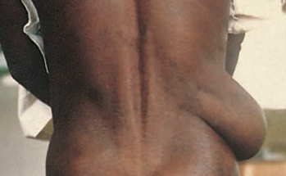
Lumbar hernia

Slide 14
others
Parastomal
Traumatic
Obturator

