Slide 1
Stomach and Duodenum
Dr. Othman Tajoury
MD,MRCS(Eng.),FEBS(Euro. Board)
Supervisor of clinical phase LIMU

Slide 2
Learning Objectives
To understand the anatomy and pathophysiology of the
stomach in relation to disease
• To be able to decide the appropriate techniques in the
investigation and treat peptic ulcer disease and its
complications
• To understand the critical importance of gastritis and
Helicobacter pylori in upper gastrointestinal disease
• To be able to recognise the presentation of gastric cancer
• To know about the causes of duodenal obstruction and
the presentation of duodenal tumours

Slide 3
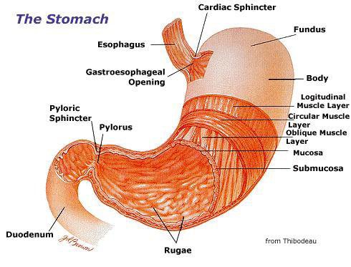
Anatomy

Slide 4
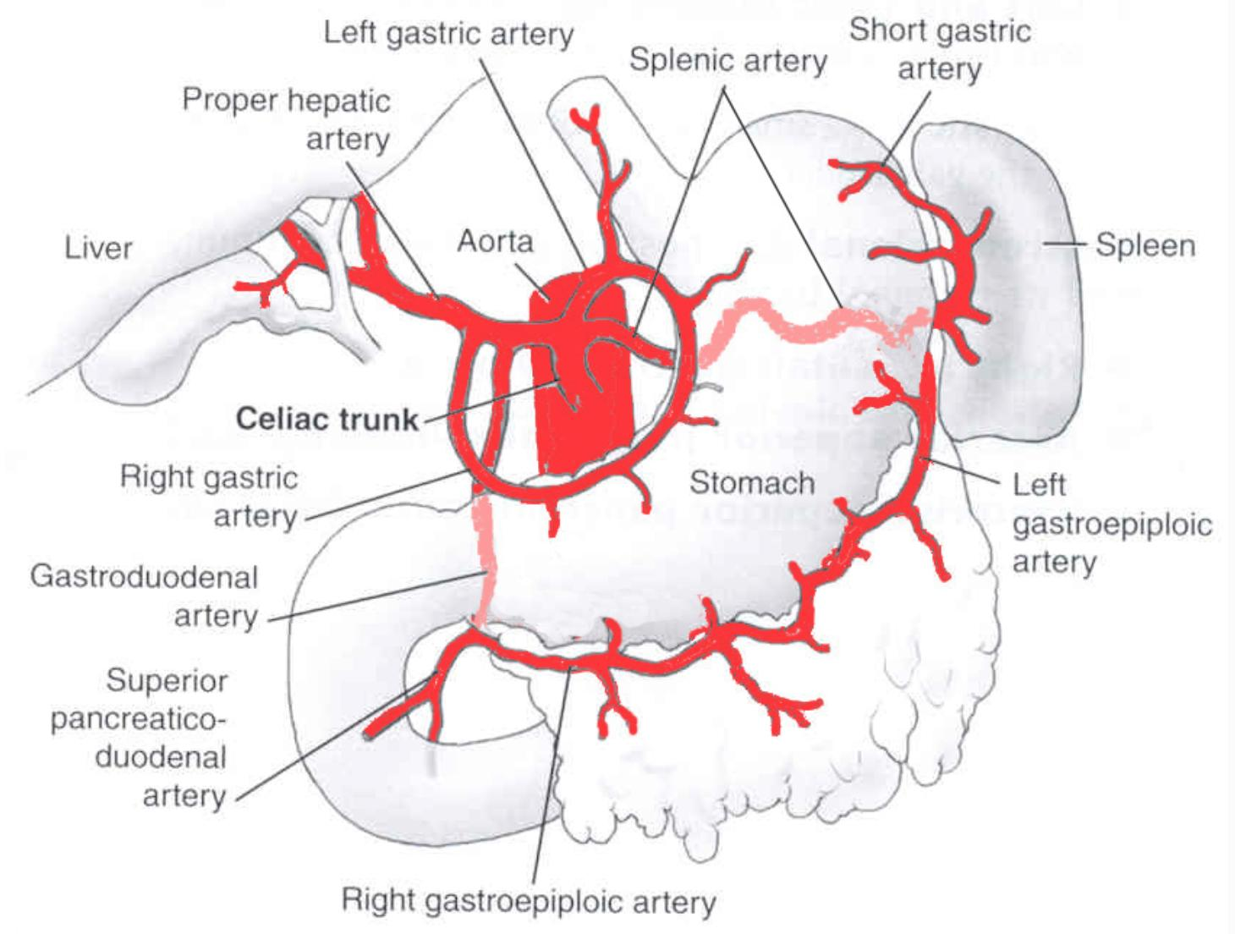

Slide 5
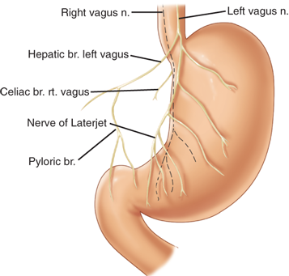

Slide 6
Cell Types
•Parietal:
•Location: Body
•Function: secrete acid and intrinsic factor
(production of hydrogen ions to form hydrochloric acid)
•Chief:
•Location: Body
•Function: produce pepsinogen I → pepsin & digestive protease
•Goblet:
•Location: Body, Antrum
•Function: mucus production

Slide 7
Cell Types
•EnteroChromaffin-Like (ECL):
•Location: Body
•Function: Histamine production
•G cells:
•Location: Antrum
•Function: Gastrin production
•D cells:
•Location: Body, Antrum
•Function: produce Somatostatin
•Endocrine cells in the duodenum produce cholecystokinin and
secretin.

Slide 8
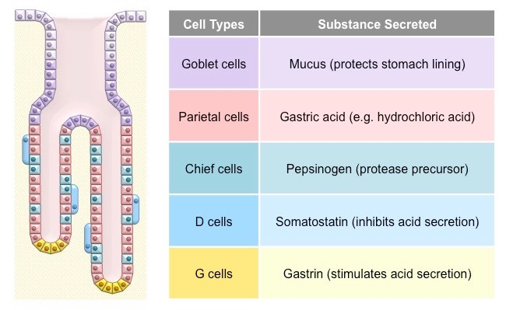

Slide 9
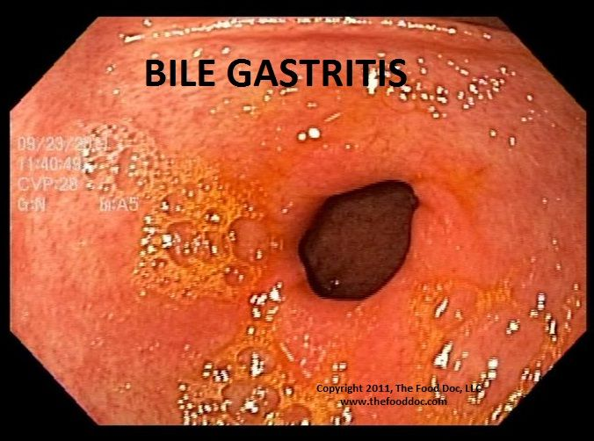
Benign Gastric Disease(s)
1- Gastritis
2- Mallory-Weiss Syndrome
3- Gastric Polyps
4- Bezoars
5- Gastric (peptic) Ulcer Disease

Slide 10
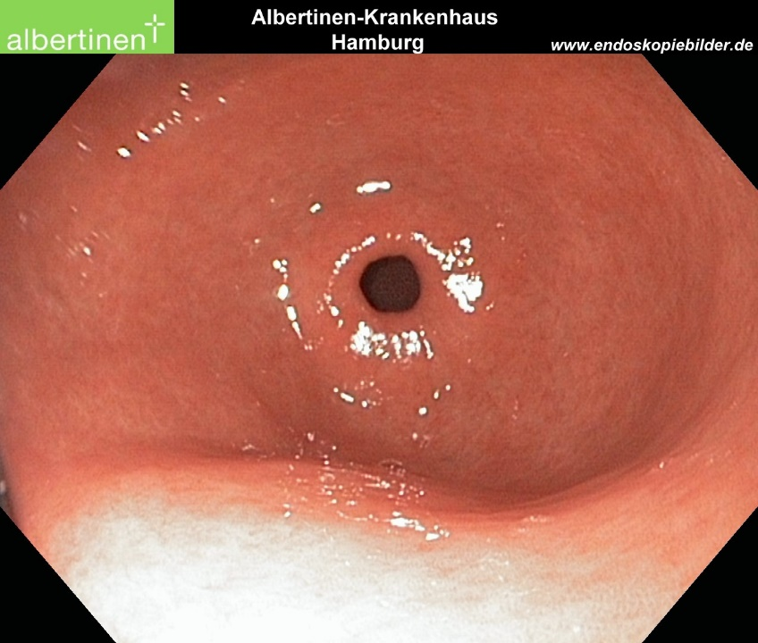
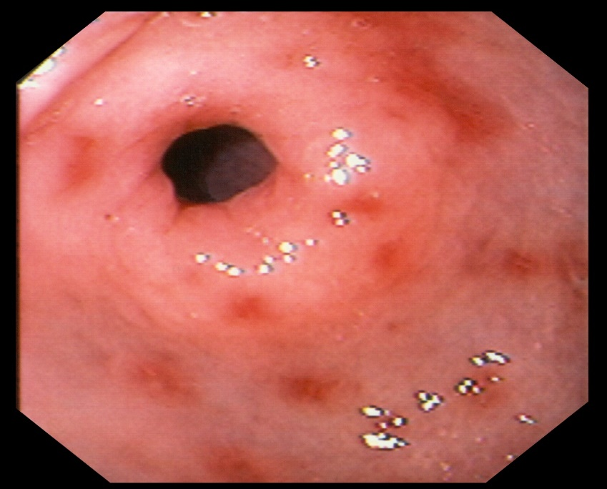
1- Gastritis
(acute or stress)
•Widespread inflammation of the mucosa.
•Causes: H. pylori, NSAIDS,
physiologic stress.

Slide 11
Types of gastritis
Type A gastritis: autoimmune, antibodies to the parietal cells.
Type B gastritis: Helicobacter-associated gastritis.
Reflux gastritis: common after gastric surgery
Erosive gastritis: NSAIDs and alcohol are common causes.
Stress gastritis: B/O reduction in the blood supply to superficial mucosa of the stomach.
Ménétrier’s disease: gross hypertrophy of the gastric mucosal folds,
premalignant.
Lymphocytic gastritis: rare

Slide 12
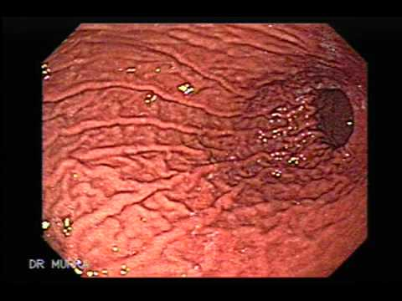
Gastritis
S&S:
•Nausea, emesis, hematemesis, melena, hematochezia, etc.
•Treatment:
Prevention, removal of offending agent.
Gastric decompression and support.
Acid suppression (PPI),
Gastrectomy in severe cases

Slide 13
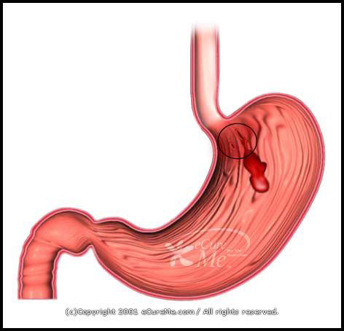
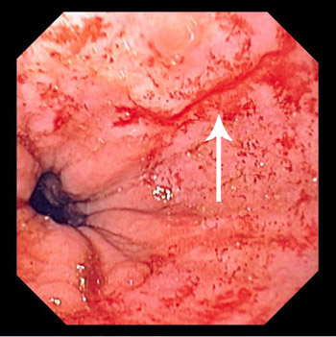
2- Mallory-Weiss Syndrome

Slide 14
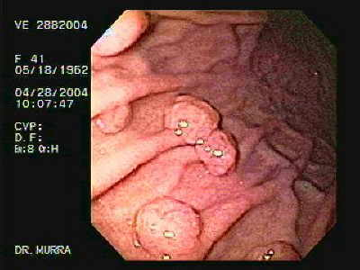
3- Gastric Polyps
•There are two types:
a- Hyperplastic
b- Adenomatous
A- Hyperplastic polyps:
•More common
•Usually benign
B- Adenomatous:
• Precancerous

Slide 15
Gastric Polyps
•Adenomatous polyps:
•Greater risk of malignancy 40% (Precancerous)
•< 0.5 cm in diameter = very low risk.
•> 1.5 cm in diameter = very high risk.
•Once a polyp is diagnosed, should be removed, 2.5% recurrence rate

Slide 16
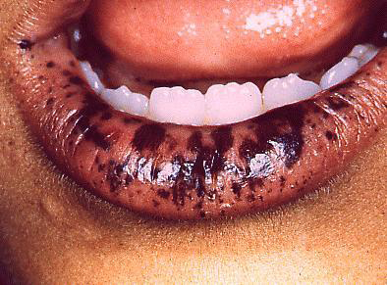
Peutz-Jegher’s Syndrome
Autosomal dominant genetic disorder characterized by the development of benign hamartomatous polyps in the gastrointestinal tract and
hyper pigmented macules on the lips and oral mucosa

Slide 17
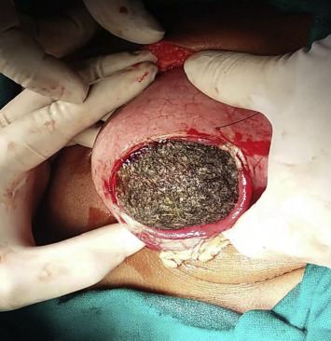
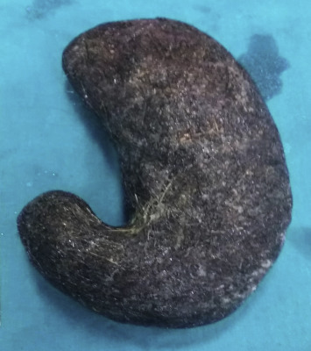
4- Bezoars
•Phytobezoars = indigestible plant material
(e.g., cellulose)
•Trichobezoars = an extreme form of hairball.

Slide 18
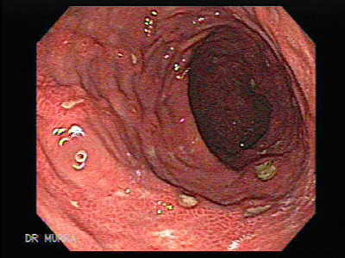
5- Gastric Ulcers

Slide 19
Pathogenesis of ulcer
Increase acid production
Lack of protection of the mucosa
•85%-95% of PU pts are colonized with H. pylori.

Slide 20
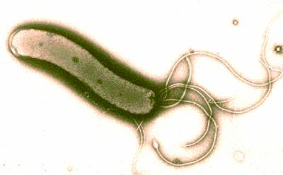
Helicobacter pylori (H. pylori)
Serological tests ;
1- H. pylori IgG antibodies (sensitivity and specificity 80% to 95% )
2- Breath test; the patient is given either 13C- or 14C-labeled urea to drink. H. pylori metabolizes the urea rapidly, and the labeled carbon is absorbed. then measured as CO2 in the patient’s expired breath to determine whether H. pylori is present (sensitivity and specificity 94% to 98%)

Slide 21

3- Upper esophagogastroduodenal endoscopy; biopsy is obtained and the diagnosis of H. pylori can be made by several methods:
• The biopsy urease test; it provides rapid testing at the time of biopsy.
• Histologic identification of organisms - considered the gold standard of diagnostic tests.
• Culture of biopsy specimens for H. pylori, when antimicrobial susceptibility testing is desired.
•Treatment: Triple therapy; amoxicillin, tetracycline
(not to be used for children <12 yrs.), metronidazole, or
clarithromycin, plus proton pump inhibitor.

Slide 22
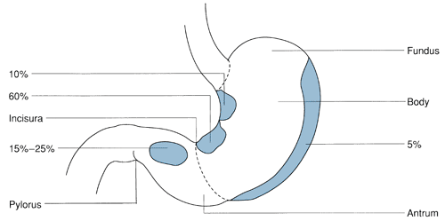
Gastric ulcers

Slide 23
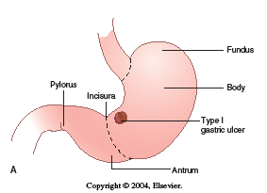
Type I
-Occur at the incisura.
-Not associated with hyperacidity
-Associated with Blood group “A”

Slide 24
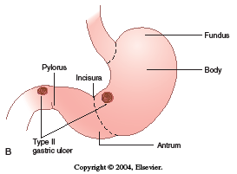
Type II
•A combination of 2 ulcers, one in the stomach, the other in the duodenum.
•Usually occur in hypersecretory states.
•Associated with Blood group“O”.

Slide 25
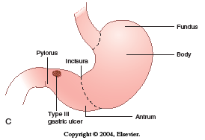
Type III
•Located pre-pyloric.
•Associated with hypersecretion.
•Type “O” blood association.
•Typically 2-3 cm from pylorus, can be multi.

Slide 26
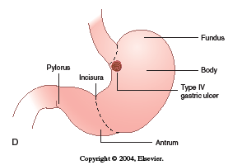
Type IV
•Occur high on lesser curve near the GE junction.
•Not associated with hypersecretion.
•Usually result from defective mucosal defense.

Slide 27
Type V
Medication-induced
(NSAID/ acetylsalicylic acid),
anywhere in stomach.

Slide 28
Complications of gastric ulcer
1. Bleeding; (penetration)
2. Perforation
3. Malignancy

Slide 29
Treatment of gastric ulcer
Medical - Prevention, triple therapy, ppi .
Surgical - in few cases
Primary goals ;
Excision of the ulcer and Reduction of acid/pepsin output
Secondary goals ;
Minimize bile reflux and gastric stasis

Slide 30
Bleeding gastric ulcer : operative procedures
Endoscopic management with biobsy
Simple oversewing with biopsy
Gastric resection including ulcer (Gastrectomy)
Excision of ulcer
with TV and drainage
without TV and drainage?

Slide 31
Perforated gastric ulcer : operative procedures
Biopsy and simple closure
Gastric resection

Slide 32
Malignant Gastric Disease
1•Adenocarcinoma
2•Lymphoma (MALToma) mucosa-associated lymphoid tissue
3•Gastrointestinal Stromal Tumor (GIST)

Slide 33
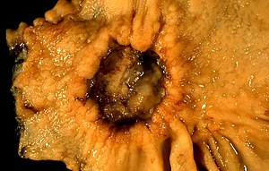
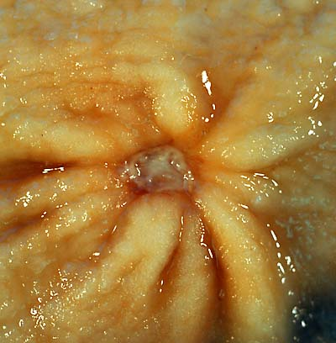
1-Gastric Adenocarcinoma

Slide 34
Gastric Adenocarcinoma
•Adenocarcinoma accounts for 95% of all gastric cancers.
•US and Europe = low risk areas
•Asia (Japan/China), Russia, Chile = high risk areas.

Slide 35
Risk Factors
•H. pylori infection.
•Pernicious anemia.
•Achlorhydria.
•Chronic gastritis.
•H/o caustic injury (corrosive ingestion)
•Adenomatous polyps.

Slide 36
Ca stomach Classification
• 4 Macroscopic types:
Cauliflower, Ulcerative, Infiltrating, Colloid.
3 Microscopic:
Adenocarcinoma95%, SCC4%. Anaplastic1%
• DIO classification:
- Diffuse
- Intestinal
- Otherwise

Slide 37
Diffuse
On top of atrophic gastritis.
•undifferentiated with classic signet-ring cells.
•Patients are usually younger.
•Associated with ABO blood group “A”.
•Spreads via lymphatics and local extension.

Slide 38
Intestinal
On top of intestinal metaplasia& Biliary gastritis
•Well differentiated with glandular elements.
•More common form in high incidence areas.
•Patients are usually older male.
•Hematogenous spread.

Slide 39
Gastric Adenocarcinoma
. Investigations :
OGD , CT , EUS , PET , Laparoscopy.
.Treatment : Depend on site of tumor
(Total ,distal or proximal Gastrectomy + LN dis section)

Slide 40
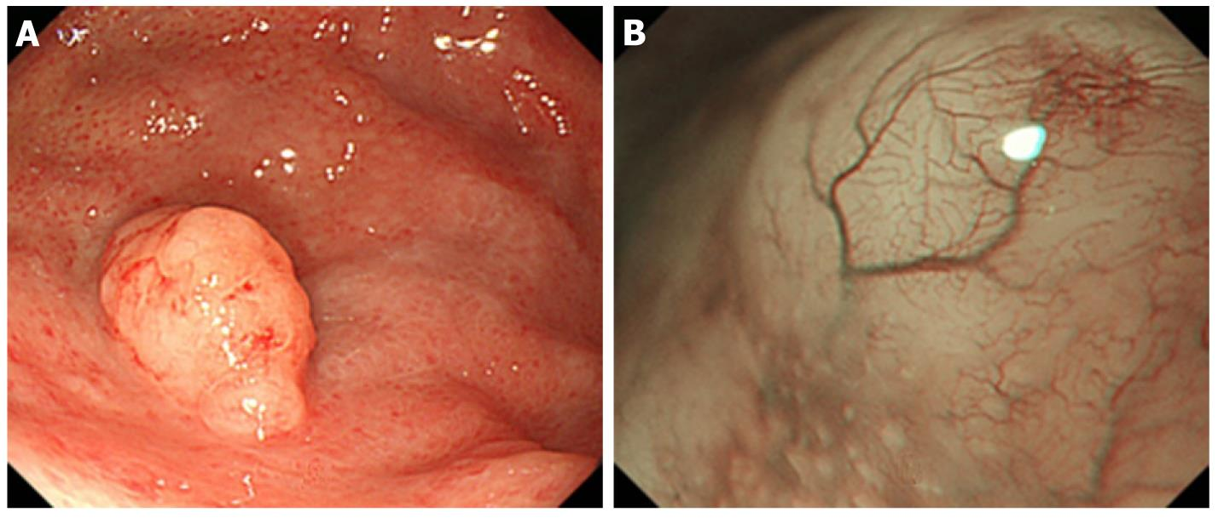
2-Gastric Lymphoma

Slide 41
Gastric Lymphoma
•Stomach is the primary site for 2/3 of all GI lymphomas.
•Predominately non-Hodgkin’s variant.
•Symptoms are similar to Adeno-ca.
•Dx: via biopsy (endoscopic vs. open).
•If Dx is made prior to surgery, do lymphoma work-up.
•Treatment: chemotherapy vs. surgery.

Slide 42
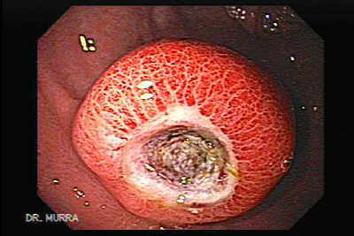
3-Gastrointestinal stromal tumors
GIST

Slide 43
GIST
•Formerly called leiomyomas or leiomyosarcomas.
•Stomach is the most common site.
•Can be “benign” or “malignant”.
•Malignant - direct invasion, mitotic
•Work-up: CT , EUSS, etc

Slide 44
Treatment:
- Surgical Resection w/ margins.
- Gleevec :
- Gleevec (imatinib mesylate) is a type of drug called
a tyrosine kinase inhibitor (TKI).
- Targeted drug therapy is different from traditional
chemotherapy in that it is very selective

Slide 45
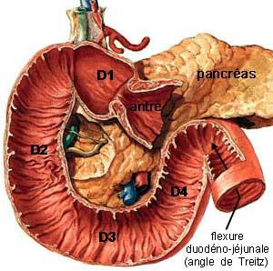
Duodenum
•4 parts
•Produces many enzymes
•D2: posterolateral insertion of ampulla.
•Becomes jejunum at the angle of Treitz

Slide 46
Benign Duodenal Disease
• Duodenal Ulcer Disease(Uncomplicated or Complicated)
• Duodenal Polyps

Slide 47
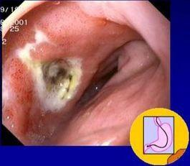
Uncomplicated Ulcer
•In contrast to gastric ulcers, duodenal ulcers rarely harbor malignancy.

Slide 48
Uncomplicated Ulcer
Important risk factors:
•H. pylori , NSAIDs , tobacco.
•Treatment : mainly medical;
( triple therapy) instead of surgical.

Slide 49
Presentation
•Burning, gnawing pain in the epigastrium.
•it may radiate to the back.
•Exacerbated by fasting.
•Relief gained from meds and eating.

Slide 50
Evaluation/Testing
• Non-invasive H. pylori testing.
(Serum antibodies, breath urease, fecal antigen).
•If (+) test = H. pylori treatment (triple therapy).
•If primary treatment fails then do upper endoscopy.
•OGD allows for visualization, biopsy, evaluation for alternate diagnosis.

Slide 51
Treatment
•Non-operative
•Remove all ulcerogenic agents.
•Start acid suppression (PPI)
•Eradicate H. pylori.

Slide 52
Treatment
•H. pylori therapy: First Line:
•Amoxicillin and Clarithromycin or
Clarithromycin and Flagyl (+) PPI
•Treat for 7 – 14 days.
•Recheck for H. pylori after treatment.
•Continue acid suppression until ulcer is healed.

Slide 53
Complicated Ulcer
•4 major manifestations:
•Perforation
•Bleeding (penetration)
•Gastric outlet obstruction
•Intractable

Slide 54
Treatment: Perforation
•Typical presentation of acute abdomen.
Resuscitation.
Operation:
1.Graham patch (omentoplasty).
2.+/- (Antrectomy with drainage) + (vagotomy).

Slide 55
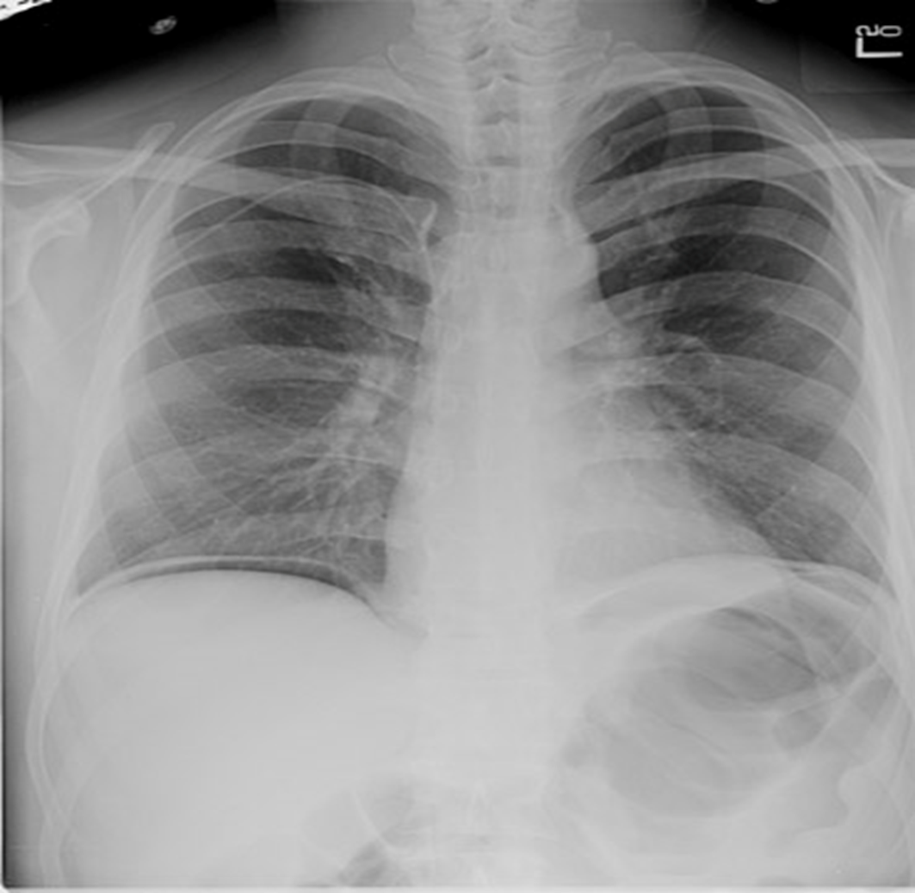

Slide 56
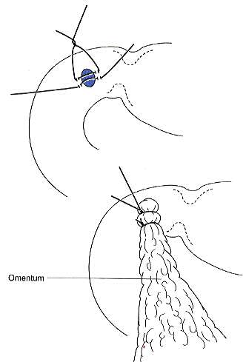

Slide 57
Bleeding
Treatment:
•Resuscitation.
•Upper endoscopy with local treatment.
•High-risk stigmata : active bleeding, visible vessel, fresh clot.
•Angiography with embolization.
•Surgical intervention.
Suturing bleeding vessel + (TV) Truncal vagotomy
and pyloroplasty PP or HSV

Slide 58
Bleeding
Indications for operative intervention:
1.Massive hemorrhage leading to shock
2.Prolonged blood loss requiring continuing transfusion
3.Recurrent bleeding during medical therapy or after endoscopic therapy
4.Recurrent bleeding requiring hospitalization
5. Rare blood groups

Slide 59
Outlet obstruction
• NPO, NG, Rehydration, Correct electrolytes.
• Some resolve (swelling).
Some Endoscopic dilatation
• Some Surgery:
-Remove obstruction (Antrectomy with drainage)
-Bypass obstruction (Gastroenterostomy).

Slide 60
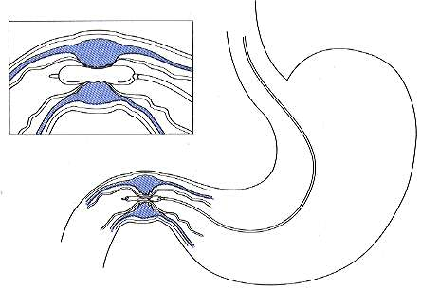

Slide 61
Intractability
Ulceration persists at 3 months despite active drug therapy
Ulcers recur within 1 year of initial healing despite maintenance therapy
The ulcer disease is characterized by cycles of prolonged activity with brief or absent remissions

Slide 62
Intractability
•Medical failure – look for other causes like,
ZE syndrome, non-compliance, etc.
•Surgery - HSV
- TV + Antrectomy
- TV + PP

Slide 63
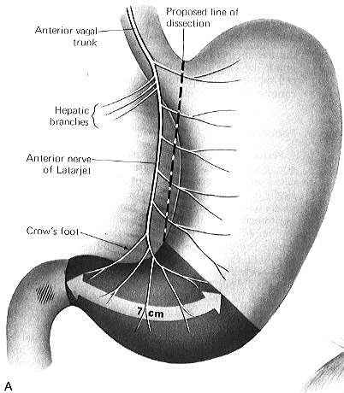

Slide 64
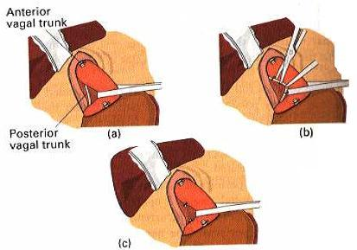

Slide 65
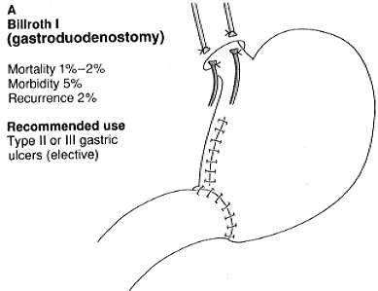

Slide 66
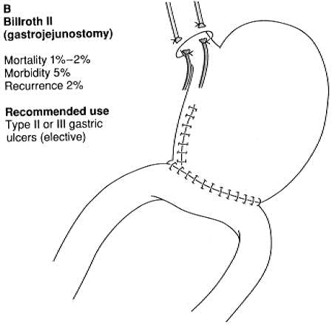

Slide 67
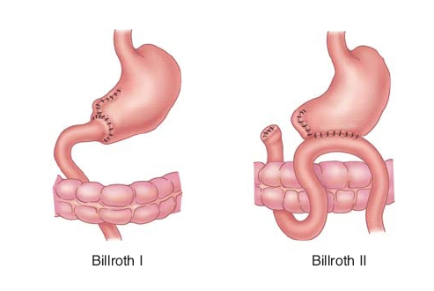

Slide 68
Drainage procedures : pyloroplasty
Heineke-Mikulicz
Finney
Jaboulay

Slide 69
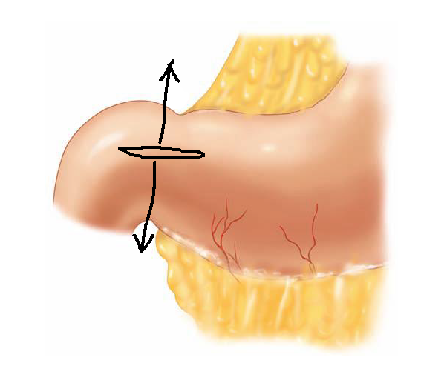
Heineke-Mikulicz pyloroplasty

Slide 70
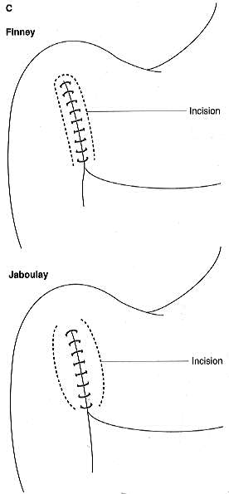

Slide 71
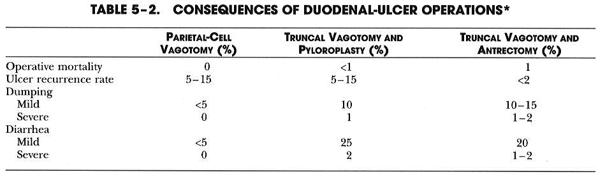

Slide 72
Duodenal polyps
Typically arise as part of a familial disorder.
•FAP.
- Autosomal dominant
- High malignant potential
•Peutz-Jegher’s syndrome.

Slide 73
Malignant Duodenal Disease
• Adenocarcinoma
• Lymphoma
Zolliger-Ellison (ZE) Syndrome (gastrinoma)

Slide 74
Adenocarcinoma
•Duodenum is the most common site for small bowel adenocarcinoma.
•~ 2/3 are peri-ampullary (D2).
•Only treatment is resection (if possible).
•Double bypass if unresectable.
•(+) LN’s = < 15%, 5 year survival.

Slide 75
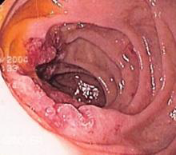
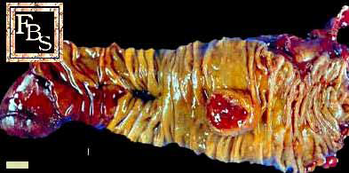
Adenocarcinoma

Slide 76
Zollinger–Ellison syndrome
•Rare disease.
•Disease is a direct result of gastrinoma.
•2/3 of gastrinomas are in the “triangle”
•Can be sporadic or hereditary.
•Strong assoc. with MEN-I (3 p’s) Pituitary, Parathyroid,
Pancreas.
•Treatment: 1- PPI
2-resection (if possible).

Slide 77
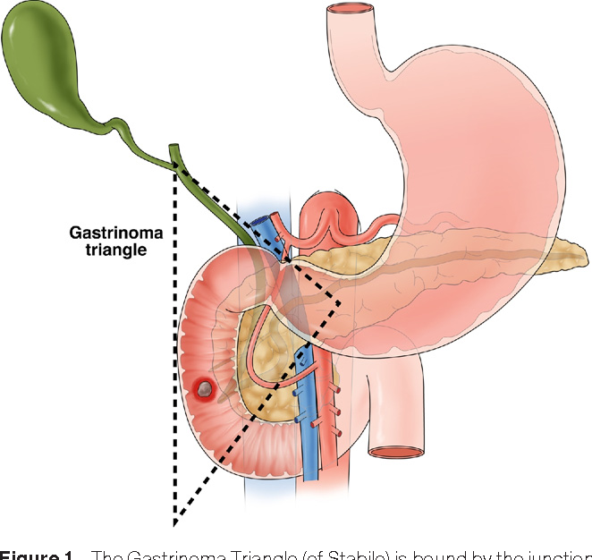
Gastrinoma
- Tumor in the pancreas or duodenum that
secretes excess of gastrin leading to ulceration in
the duodenum, stomach and the small intestine.
- There is hypersecretion of HCl.
- Gastrinoma triangle; region in between three
points:
- Superior- Body of Gallbladder.
- Inferior-junction of the second and third portion
of duodenum.
- Medial- junction of the neck and body of
the pancreas.

Slide 78
Lymphoma
•Rare, most small bowel lymphomas are ileal.
•Similar presentation to adenocarcinoma.
•Diagnose the same as gastric lymphoma.
•Resection if resectable.
•Chemotherapy and radiation.

Slide 79
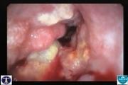
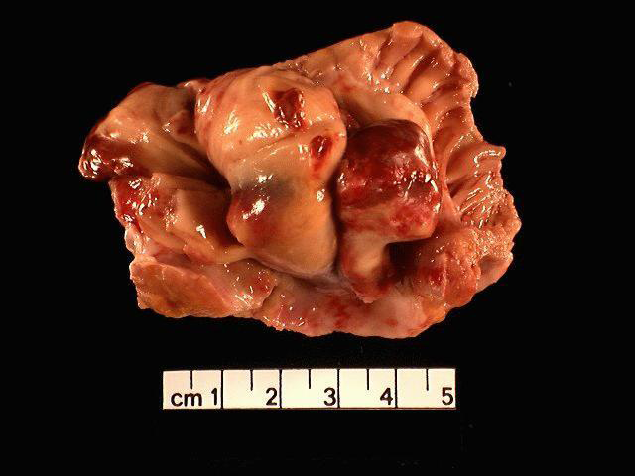
Lymphoma

Slide 80
Thank you

