Slide 1
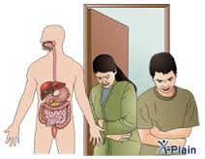

Malabsorption Syndromes
DR. Nadia ezzawi
Gastroenterology department
BMC

Slide 2
Learning objectives
Understand definition of malabsorption.
Discuss causes and mechanism of malabsorption.
Discuss commonest diseases associated with malabsorption such as celiac sprue , Short Bowel Syndrome, Bacterial overgrowth syndrome and tropical sprue.

Slide 3
MALABSORPTION SYNDROME
* Definition:
-It is a state arising from abnormality in absorption of food nutrients across the gastrointestinal tract(GIT).
-Impairment can be of single or multiple nutrients depending on the abnormality.
-This may lead to malnutrition and a variety of anaemias.

Slide 4
* Pathophysiology:
The main purpose of the gastrointestinal tract is to digest and absorb nutrients (fat, carbohydrate, protein, and fiber), micronutrients (vitamins and trace minerals), water, and electrolytes.
Digestion involves both mechanical and enzymatic breakdown of food:
    - Mechanical processes include chewing, and the to-and-fro mixing in the small intestine.
    - Enzymatic hydrolysis is initiated by intraluminal processes requiring gastric, pancreatic, and biliary secretions.
    The final products of digestion are absorbed through the intestinal epithelial cells.

Slide 5
Malabsorption constitutes the pathological interference with the normal physiological sequence of digestion (intraluminal process), absorption (mucosal process) and transport (postmucosal events) of nutrients.
Intestinal malabsorption can be due to:
  1. digestive failure caused by enzyme deficiencies
  2. structural defects
  3. mucosal abnormality
  4. infective agents
  5. systemic diseases affecting GI tract

Slide 6
1. Due to digestive failure:
Pancreatic insufficiencies:
  cystic fibrosis
  chronic pancreatitis
  carcinoma of pancreas
Bile salt insufficiency:
  obstructive jaundice
  bacterial overgrowth
2. Due to structural defects:
Inflammatory bowel diseases commonly: Crohn's Disease
Gastrectomy and gastro-jejunostomy
Fistulae, diverticulae and strictures.
Infiltrative conditions such as amyloidosis, lymphoma.
Eosinophilic gastroenteropathy.
Radiation enteritis.
Systemic sclerosis and collagen vascular diseases.
Short bowel syndrome.

Slide 7
3. Due to mucosal abnormality:
-Coeliac disease.
4. Due to enzyme deficiencies:
-Lactase deficiency inducing lactose intolerance.
- Disaccharidase deficiency.
- Enteropeptidase eficiency
5. Due to infective agents:
-Whipple's disease
-Intestinal tuberculosis
-Tropical sprue
-Parasites e.g. Giardia lamblia.

Slide 8
6. Due to other systemic diseases affecting GI tract:
-Hypothyroidism and hyperthyroidism.
-Diabetes mellitus.
-Hyperparathyroidism and Hypoparathyroidism.
-Carcinoid syndrome.
-Malnutrition.

Slide 9
* Clinical picture:
Symptoms can be
intestinal
extra-intestinal
Intestinal :-
Diarrhoea, often steatorrhoea :
It is due to impaired water, carbohydrate and electrolyte absorption.
bloating, flatulence and abdominal discomfort.
Extraintestinal :-
Weight loss .
Growth retardation, failure to thrive, delayed puberty in children.
Swelling or edema from loss of protein.
Anaemias, commonly from vitamin B₁₂, folic acid and iron deficiency presenting as fatigue and weakness.
Muscle cramp from decreased vitamin D, calcium absorption. Also lead to osteomalacia and osteoporosis.
Bleeding tendencies from vitamin K and other coagulation factor deficiency.

Slide 10
Specific Disease Entities causing malabsorption

Slide 11
Celiac Disease:
- is a common cause of malabsorption
- Age: occurring at ages ranging from
the first year of life through the eighth decade.
Etiology: is not known, but three factors can contribute:
1. Environmental factor:
- There is association of the disease with gliadin, a component of gluten that is present in wheat.
2. Immunologic factor:
- Serum antibodies are detected such as anti-gliadin.
3. Genetic factor:
- Almost all patients express the B8, DR3, DR7& HLA-DQ2

Slide 12
Pathology
A small-intestinal biopsy should be done for suspected patients.
The hallmark of celiac sprue is the presence of an abnormal small-intestinal biopsy.
If possible, grade the results according to the Marsh criteria.

Slide 13
Marsh criteria
Histologic changes on small intestinal biopsy
0: normal villous architecture with no increase in intraepithelial lymphocytes
I: normal villous architecture with increased intraepithelial lymphocytes
II: increased intraepithelial lymphocytes and crypt hyperplasia with normal villi
IIIa: increased intraepithelial lymphocytes and crypt hyperplasia with partial villous atrophy
IIIb: increased intraepithelial lymphocytes and crypt hyperplasia with subtotal villous atrophy
IIIc: increased intraepithelial lymphocytes and crypt hyperplasia with total villous atrophy

Slide 14
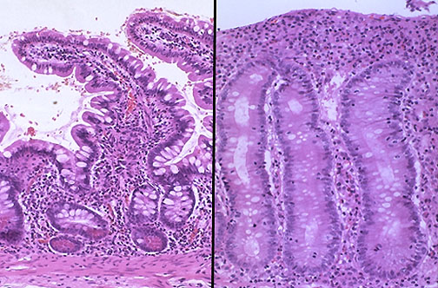
Normal small intestinal mucosa is seen at the left, and mucosa involved by celiac sprue at the right Show blunting and flattening of villi with increased lymphocytes and plasma cells in the lamina propria in celiac disease

Slide 15
Clinical features
The disease usually presents in children, less commonly manifested in adults for the first time :
Diarrhea.
Wieght loss.
Anemia.
Other manifestations of vitamin and nutrient deficiencies .
Recognised complications of coeliac:
-lymophoma or gastrointestinal carcinoma: manifested by
*Incomplete respond to gluten free diet.
*Absent features of generalized lymphoma.
*Perforation, Bleeding ,Intestinal obstruction
* treatment: Chemotherapy & Surgery
-ulcerative jejuno-ileitis.

Slide 16
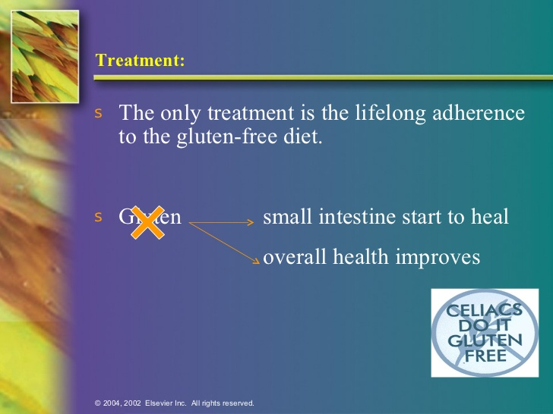
Treatment

Slide 17
Subgroups of celiac disease
1. Classic celiac disease
.
2. Atypical celiac disease: lacks the typical gastrointestinal symptoms of malabsorption; presents with deficiency states (e.g., iron deficiency) or extra intestinal manifestations (e.g., fatigue, elevated liver enzymes, or infertility).
3. Silent celiac disease: .
4. Nonresponsive celiac disease: clinical symptoms or laboratory abnormalities typical of celiac disease fail to improve within 6 months of gluten withdrawal, or typical symptoms or laboratory abnormalities recur while the patient is on a gluten-free diet.
5. Refractory celiac disease: specific diagnosis within the category of nonresponsive celiac
disease, defined as the persistence of clinical symptoms and histologic abnormalities after
at least 6 months on a strict gluten-free diet and in the absence of other evident causes or
of overt lymphoma. The incidence of refractory celiac disease in patients with celiac disease is not well known but is felt to be approximately 1%.

Slide 18
2.Tropical Sprue
Caused by infectious agents including Giardia lamblia, Yersinia enterocolitica, Clostridum difficile.
common in tropical areas.
pathological features resemble that of coeliac ( partial villous atrophy).
* sreatorrhea.
*xylose malabsorption.
*vit B12 malabsorption.
*hypoalbuminemia.

Slide 19
3. Short Bowel Syndrome
Following surgical resection of t.ileum , or jujenum.
diarrhea and/or steatorrhea can appear due to decrease in the area of the absorptive surface.

Slide 20
4.Bacterial Overgrowth Syndrome
- There is proliferation of colonic-type bacteria within the small intestine.
- Due to stasis caused by impaired peristalsis . This lead to diarrhea and malabsorption.
* Bacterial over growth leads to:
1. Metabolize bile salt resulting in deconjugation of bile salts;
  → ↓ Bile Salt and malabsorption of fat.
2. Damage of the intestinal villi by:
• Bacterial invasion
• Toxin
• Metabolic products
→ Damaged villi → cause total villous atrophy.

Slide 21
Cause of bacterial growth.
e.g.
  Small intestinal diverticuli.
  Blind loop.
  Strictures.
  DM/ Scleroderma.
Clinically:
• Steatorrhea
• Anaemia
• B12 def.
Reversed of symptom after antibiotic treatment.
Diagnosis:
• Breath test. (Carbohydrate malabsorption).
• xylose test. ( fat malabsoeption).
• Culture of aspiration (definitive)
Treatment: Antibiotic
• Tetracyclin
• Ciproflexacin
• Metronidazole
• Amoxil

Slide 22
5. Lactose intolerance
Deficiency of lactase enzyme in small intestine.
Lactose cannt be hydrolised=== passes into the colon === ferminted=== FA, H2, CO2=====Diarrhea .
Primary . Racial
Secondary: coeliac, tropical sprue , ceohns disease , GE.
Management : lactose free diet.

Slide 23
